Slide 1
Database Management Systems
By:
Dr. Neha Nandal
Computer Science and Engineering

Slide 2
Geethanjali College of Engineering and Technology
Department of Computer Science and Engineering
Database Management Systems (25CS21003)
Course Syllabus — New Syllabus 2025–26
UNIT I — Introduction & Database Design
Database System Applications A Historical Perspective; File Systems versus a DBMS; the Data Model; Levels of Abstraction in a DBMS; Data Independence; Structure of a DBMS.
Introduction to Database Design Database Design and ER Diagrams; Entities, Attributes, and Entity Sets; Relationships and Relationship Sets; Additional Features of the ER Model; Conceptual Design with the ER Model.
UNIT II — Relational Model, Algebra & Schema Refinement
Introduction to the Relational Model Integrity constraints over relations; enforcing integrity constraints; querying relational data; logical database design; introduction to views; destroying / altering tables and views.
Relational Query Languages Relational Algebra; Tuple Relational Calculus; Domain Relational Calculus.
Schema Refinement Problems caused by redundancy; decompositions; problems related to decomposition; reasoning about functional dependencies; First, Second, Third Normal Forms; BCNF; lossless join decomposition; multivalued dependencies; Fourth Normal Form; Fifth Normal Form.

Slide 3
UNIT III — SQL & NoSQL Databases
SQL Languages DDL, DML, TCL, DCL.
SQL Queries, Constraints, Triggers Form of a basic SQL query; UNION, INTERSECT, and EXCEPT; Nested Queries; aggregation operators; NULL values; complex integrity constraints in SQL; triggers and active databases.
NoSQL Databases Introduction, Overview, and History of NoSQL Databases; the definition of the four types of NoSQL databases; comparison of relational databases to NoSQL; SQL vs NoSQL; basic CRUD operations using MongoDB.
UNIT IV — Transaction Management & Recovery
Transaction Management Transaction Concept; Transaction State; Implementation of Atomicity and Durability; Concurrent Executions; Serializability; Recoverability; Implementation of Isolation; testing for serializability; Lock-Based Protocols; Timestamp-Based Protocols; Validation-Based Protocols; Multiple Granularity.
Recovery System Recovery and Atomicity; Log-Based Recovery; Recovery with Concurrent Transactions; Buffer Management; Failure with loss of non-volatile storage; Advanced Recovery systems; Remote Backup systems.

Slide 4
UNIT V — Storage and Indexing
Storage and Indexing File Organization and Indexing; Cluster Indexes; Primary and Secondary Indexes; Index Data Structures; Hash-Based Indexing; Tree-Based Indexing; Comparison of File Organizations.
Tree-Based Indexing Indexes — intuitions for tree indexes; Indexed Sequential Access Methods (ISAM); B+ Trees: A Dynamic Index Structure.
Storing and Retrieving Storing and retrieving images; storing and retrieving files.
TEXT BOOKS:
1. Data base System Concepts, Silberschatz, Korth, McGraw hill, Sixth Edition.(All UNITS except III th)
2. Data base Management Systems, Raghurama Krishnan, Johannes Gehrke, TATA McGrawHill 3rd Edition.

Slide 5
Unit 2: RELATIONAL ALGEBRA
Relational Algebra is a procedural query language. Relational algebra mainly provides a theoretical foundation for relational databases and SQL. The main purpose of using Relational Algebra is to define operators that transform one or more input relations into an output relation.
As it is pure mathematics, there is no use of English Keywords in Relational Algebra and operators are represented using symbols.

Slide 6
Fundamental Operators
These are the basic/fundamental operators used in Relational Algebra.
Selection(σ)
Projection(π)
Union(U)
Set Difference(-)
Set Intersection(∩)
Rename(ρ)
Cartesian Product(X)

Slide 7
1. Selection(σ):
It is used to select required tuples of the relations.
A | B | C
1 | 2 | 4
2 | 2 | 3
3 | 2 | 3
4 | 3 | 4
A | B | C
1 | 2 | 4
4 | 3 | 4
For this relation, σ(c>3)R will select the tuples which have c more than 3.
Note: The selection operator only selects the required tuples but does not display them. For display, the data projection operator is used.

Slide 8
2. Projection(π):
It is used to project required column data from a relation.
Consider Table 1. Suppose we want columns B and C from Relation R.
π(B,C)R will show following columns.
B | C
2 | 4
2 | 3
3 | 4
Note: By Default, projection removes duplicate data.

Slide 9
3. Union(U):
Union operation in relational algebra is the same as union operation in set theory.
FRENCH
GERMAN
Student_Name | Roll_Number
Ram | 01
Mohan | 02
Vivek | 13
Geeta | 17
Student_Name | Roll_Number
Vivek | 13
Geeta | 17
Shyam | 21
Rohan | 25
Consider the following table of Students having different optional subjects in their course.
π(Student_Name)FRENCH U π(Student_Name)GERMAN

Slide 10
Student_Name
Ram
Mohan
Vivek
Geeta
Shyam
Rohan
Note: The only constraint in the union of two relations is that both relations must have the same set of Attributes.

Slide 11
4. Set Difference(-):
Set Difference in relational algebra is the same set difference operation as in set theory.
From the previous table of FRENCH and GERMAN, Set Difference is used as follows
π(Student_Name)FRENCH - π(Student_Name)GERMAN
Student_Name
Ram
Mohan
Note: The only constraint in the Set Difference between two relations is that both relations must have the same set of Attributes.

Slide 12
5. Rename(ρ): Rename is a unary operation used for renaming attributes of a relation.
ρb(a)R will rename the attribute 'b' of the relation by 'a'.

Slide 13
6. Cross Product(X): Cross-product between two relations. Let’s say A and B, so the cross product between A X B will result in all the attributes of A followed by each attribute of B. Each record of A will pair with every record of B.
Name | Age | Sex
Ram | 14 | M
Sona | 15 | F
Kim | 20 | M
ID | Course
1 | DS
2 | DBMS

Slide 14
A X B
Name | Age | Sex | ID | Course
Ram | 14 | M | 1 | DS
Ram | 14 | M | 2 | DBMS
Sona | 15 | F | 1 | DS
Sona | 15 | F | 2 | DBMS
Kim | 20 | M | 1 | DS
Kim | 20 | M | 2 | DBMS

Slide 15
Derived Operators
These are some of the derived operators, which are derived from the fundamental operators.
Natural Join(⋈)
Intersection
Conditional Join
Division
1. Natural Join(⋈): Natural join is a binary operator. Natural join between two or more relations will result in a set of all combinations of tuples where they have an equal common attribute.

Slide 16
DEPT
EMP
Name | ID | Dept_Name
A | 120 | IT
B | 125 | HR
C | 110 | Sales
D | 111 | IT
Dept_Name | Manager
Sales | Y
Production | Z
IT | A

Slide 17
Natural join between EMP and DEPT with condition :
EMP.Dept_Name = DEPT.Dept_Name
EMP ⋈ DEPT
Name | ID | Dept_Name | Manager
A | 120 | IT | A
C | 110 | Sales | Y
D | 111 | IT | A

Slide 18
Set Intersection(∩): Set Intersection in relational algebra is the same set intersection operation in set theory.
Example: From the above table of FRENCH and GERMAN, the Set Intersection is used as follows
π(Student_Name)FRENCH ∩ π(Student_Name)GERMAN
Student_Name
Vivek
Geeta
Note: The only constraint in the Set Difference between two relations is that both relations must have the same set of Attributes.

Slide 19
SQL | DIVISION
Division in SQL is typically required when you want to find out entities that are interacting with all entities of a set of different types of entities. The division operator is used when we have to evaluate queries that contain the keyword ‘all’.
The division operator is used for queries which involve the 'all'.
R1 ÷ R2 = tuples of R1 associated with all tuples of R2.

Slide 20
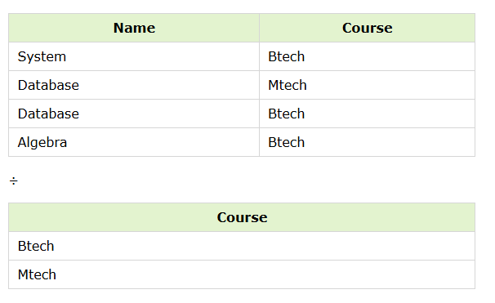

Slide 21
Retrieve the name of the subject that is taught in all courses.
The resulting operation must have all combinations of tuples of relation S that are present in the first relation or R.

Slide 22
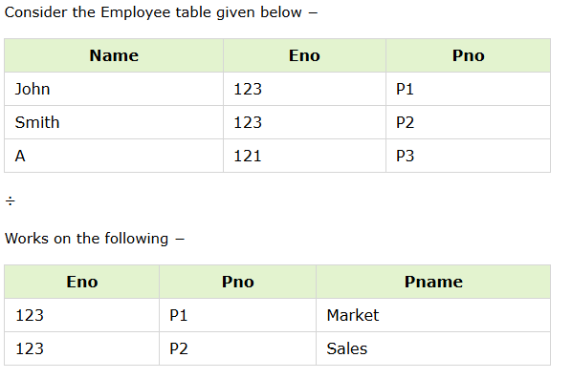

Slide 23
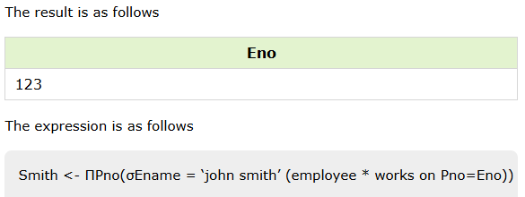
Retrieve names of employees who work on all the projects that John Smith works on.

Slide 24
Question:
Consider the following relational database schema consisting of the four relation schemas:
passenger ( pid, pname, pgender, pcity)
agency ( aid, aname, acity)
flight (fid, fdate, time, src, dest)
booking (pid, aid, fid, fdate)
a) Get the complete details of all flights to New Delhi.

Slide 25
Question:
Consider the following relational database schema consisting of the four relation schemas:
passenger ( pid, pname, pgender, pcity)
agency ( aid, aname, acity)
flight (fid, fdate, time, src, dest)
booking (pid, aid, fid, fdate)
a) Get the complete details of all flights to New Delhi.
SELECT * FROM flight WHERE dest = 'New Delhi';
σ _{destination = “New Delhi”} (flight)

Slide 26
Question:
Consider the following relational database schema consisting of the four relation schemas:
passenger ( pid, pname, pgender, pcity)
agency ( aid, aname, acity)
flight (fid, fdate, time, src, dest)
booking (pid, aid, fid, fdate)
b) Get the details about all flights from Chennai to New Delhi.

Slide 27
Question:
Consider the following relational database schema consisting of the four relation schemas:
passenger ( pid, pname, pgender, pcity)
agency ( aid, aname, acity)
flight (fid, fdate, time, src, dest)
booking (pid, aid, fid, fdate)
b) Get the details about all flights from Chennai to New Delhi.
SELECT * FROM flight WHERE src = 'Chennai' AND dest = 'New Delhi';
σ src = “Chennai” ^ dest = “New Delhi” (flight)

Slide 28
Question:
Consider the following relational database schema consisting of the four relation schemas:
passenger ( pid, pname, pgender, pcity)
agency ( aid, aname, acity)
flight (fid, fdate, time, src, dest)
booking (pid, aid, fid, fdate)
c) Find only the flight numbers for passenger with pid 123 for flights to Chennai before 06/11/2020.

Slide 29
Question:
Consider the following relational database schema consisting of the four relation schemas:
passenger ( pid, pname, pgender, pcity)
agency ( aid, aname, acity)
flight (fid, fdate, time, src, dest)
booking (pid, aid, fid, fdate)
c) Find only the flight numbers for passenger with pid 123 for flights to Chennai before 06/11/2020.
SELECT b.fid FROM booking b JOIN flight f ON b.fid = f.fid WHERE b.pid = 123 AND f.dest = 'Chennai' AND b.fdate < '2020-11-06';
Πfid​(σpid=123 ∧ dest=′Chennai′ ∧ fdate<′06/11/2020′​(booking⋈flight))
Π _{fid} (σ _{pid = 123} (booking) ⨝ σ dest = “Chennai” ^ fdate < 06/11/2020 (flight))

Slide 30
Question:
Consider the following relational database schema consisting of the four relation schemas:
passenger ( pid, pname, pgender, pcity)
agency ( aid, aname, acity)
flight (fid, fdate, time, src, dest)
booking (pid, aid, fid, fdate)
d) Find the passenger names for passengers who have bookings on at least one flight.

Slide 31
Question:
Consider the following relational database schema consisting of the four relation schemas:
passenger ( pid, pname, pgender, pcity)
agency ( aid, aname, acity)
flight (fid, fdate, time, src, dest)
booking (pid, aid, fid, fdate)
d) Find the passenger names for passengers who have bookings on at least one flight.
SELECT DISTINCT p.pname FROM passenger p JOIN booking b ON p.pid = b.pid;
Π _{pname} (passenger ⨝ booking)

Slide 32
Question:
Consider the following relational database schema consisting of the four relation schemas:
passenger ( pid, pname, pgender, pcity)
agency ( aid, aname, acity)
flight (fid, fdate, time, src, dest)
booking (pid, aid, fid, fdate)
e) Find the passenger names for those who do not have any bookings in any flights.

Slide 33
Question:
Consider the following relational database schema consisting of the four relation schemas:
passenger ( pid, pname, pgender, pcity)
agency ( aid, aname, acity)
flight (fid, fdate, time, src, dest)
booking (pid, aid, fid, fdate)
e) Find the passenger names for those who do not have any bookings in any flights.
SELECT pname FROM passenger WHERE pid NOT IN ( SELECT pid FROM booking );
Π _{pname} ((Π _{pid} (passenger) - Π _{pid} (booking)) ⨝ passenger)

Slide 34
Question:
Consider the following relational database schema consisting of the four relation schemas:
passenger ( pid, pname, pgender, pcity)
agency ( aid, aname, acity)
flight (fid, fdate, time, src, dest)
booking (pid, aid, fid, fdate)
f) Find the agency names for agencies that located in the same city as passenger with passenger id 123.

Slide 35
Question:
Consider the following relational database schema consisting of the four relation schemas:
passenger ( pid, pname, pgender, pcity)
agency ( aid, aname, acity)
flight (fid, fdate, time, src, dest)
booking (pid, aid, fid, fdate)
f) Find the agency names for agencies that located in the same city as passenger with passenger id 123.
SELECT aname FROM agency WHERE acity = ( SELECT pcity FROM passenger WHERE pid = 123 );
SELECT a.aname FROM agency a JOIN passenger p ON a.acity = p.pcity WHERE p.pid = 123;
Π _{aname} (agency ⨝ _{acity = pcity} (σ _{pid = 123} (passenger)))

Slide 36
Question:
Consider the following relational database schema consisting of the four relation schemas:
passenger ( pid, pname, pgender, pcity)
agency ( aid, aname, acity)
flight (fid, fdate, time, src, dest)
booking (pid, aid, fid, fdate)
g) Get the details of flights that are scheduled on both dates 01/12/2020 and 02/12/2020 at 16:00 hours.

Slide 37
Question:
Consider the following relational database schema consisting of the four relation schemas:
passenger ( pid, pname, pgender, pcity)
agency ( aid, aname, acity)
flight (fid, fdate, time, src, dest)
booking (pid, aid, fid, fdate)
g) Get the details of flights that are scheduled on both dates 01/12/2020 and 02/12/2020 at 16:00 hours.
(σ fdate = 01/12/2020 ^ time = 16:00 (flight)) ∩ (σ fdate = 02/12/2020 ^ time = 16:00 (flight))
SELECT f1.fid, f1.fdate, f1.time, f1.src, f1.dest FROM flight f1 JOIN flight f2
ON f1.fid = f2.fid
WHERE f1.fdate = '2020-12-01' AND f1.time = '16:00'
AND f2.fdate = '2020-12-02' AND f2.time = '16:00';

Slide 38
F1​←ρF1​​(σfdate=′01/12/2020′ ∧ time=′16:00′​(flight)) F2←ρF2(σfdate=′02/12/2020′ ∧ time=′16:00′(flight))
π (F1.fid, F1.fdate, F1.time, F1.src, F1.dest) ( F1 ⋈(F1.fid = F2.fid) F2)

Slide 39
Question:
Consider the following relational database schema consisting of the four relation schemas:
passenger ( pid, pname, pgender, pcity)
agency ( aid, aname, acity)
flight (fid, fdate, time, src, dest)
booking (pid, aid, fid, fdate)
h) Get the details of flights that are scheduled on either of the dates 01/12/2020 or 02/12/2020 or both at 16:00 hours.

Slide 40
Question:
Consider the following relational database schema consisting of the four relation schemas:
passenger ( pid, pname, pgender, pcity)
agency ( aid, aname, acity)
flight (fid, fdate, time, src, dest)
booking (pid, aid, fid, fdate)
h) Get the details of flights that are scheduled on either of the dates 01/12/2020 or 02/12/2020 or both at 16:00 hours.
SELECT * FROM flight
WHERE (fdate = '2020-12-01' OR fdate = '2020-12-02')
AND time = '16:00:00';
(σ fdate = 01/12/2020 ^ time = 16:00 (flight)) ∪ (σ fdate = 02/12/2020 ^ time = 16:00 (flight))

Slide 41
Question:
Consider the following relational database schema consisting of the four relation schemas:
passenger ( pid, pname, pgender, pcity)
agency ( aid, aname, acity)
flight (fid, fdate, time, src, dest)
booking (pid, aid, fid, fdate)
i) Find the agency names for agencies who do not have any bookings for passenger with id 123.

Slide 42
Question:
Consider the following relational database schema consisting of the four relation schemas:
passenger ( pid, pname, pgender, pcity)
agency ( aid, aname, acity)
flight (fid, fdate, time, src, dest)
booking (pid, aid, fid, fdate)
i) Find the agency names for agencies who do not have any bookings for passenger with id 123.
Π _{aname} (agency ⨝ (Π _{aid} (agency) – Π _{aid} (σ _{pid = 123} (booking)))
SELECT a.aname FROM agency a LEFT JOIN booking b ON a.aid = b.aid AND b.pid = 123 WHERE b.aid IS NULL;
SELECT aname FROM agency WHERE aid NOT IN ( SELECT aid FROM booking WHERE pid = 123 );

Slide 43
Question:
Consider the following relational database schema consisting of the four relation schemas:
passenger ( pid, pname, pgender, pcity)
agency ( aid, aname, acity)
flight (fid, fdate, time, src, dest)
booking (pid, aid, fid, fdate)
j) Find the details of all male passengers who are associated with Jet agency.

Slide 44
Question:
Consider the following relational database schema consisting of the four relation schemas:
passenger ( pid, pname, pgender, pcity)
agency ( aid, aname, acity)
flight (fid, fdate, time, src, dest)
booking (pid, aid, fid, fdate)
j) Find the details of all male passengers who are associated with Jet agency.
Π _{passengers.pid, pname, pcity} (σ pgender = “Male” ^ aname = ‘Jet’ (passengers ⨝ booking ⨝ agency))
SELECT p.pid, p.pname, p.pgender, p.pcity FROM passenger p JOIN booking b ON p.pid = b.pid JOIN agency a ON b.aid = a.aid WHERE p.pgender = 'male' AND a.aname = 'Jet';

Slide 45
Relational Calculus
As Relational Algebra is a procedural query language, Relational Calculus is a non-procedural query language. It basically deals with the end results. It always tells me what to do but never tells me how to do it.
There are two types of Relational Calculus
Tuple Relational Calculus(TRC)
Domain Relational Calculus(DRC)

Slide 46
Tuple Relational Calculus (TRC) is a non-procedural query language used in relational database management systems (RDBMS) to retrieve data from tables. TRC is based on the concept of tuples, which are ordered sets of attribute values that represent a single row or record in a database table.
TRC is a declarative language, meaning that it specifies what data is required from the database, rather than how to retrieve it. TRC queries are expressed as logical formulas that describe the desired tuples.
Syntax: The basic syntax of TRC is as follows:
{ t | P(t) }
where t is a tuple variable and P(t) is a logical formula that describes the conditions that the tuples in the result must satisfy. The curly braces {} are used to indicate that the expression is a set of tuples.

Slide 47
Employee ID
Name
Salary
Department ID
To retrieve the names of all employees who earn more than $50,000 per year, we can use the following TRC query:
{ t | Employees(t) ∧ t.Salary > 50000 }
In this query, the “Employees(t)” expression specifies that the tuple variable t represents a row in the “Employees” table. The “∧” symbol is the logical AND operator, which is used to combine the condition “t.Salary > 50000” with the table selection.

Slide 48
In Tuple Calculus, a query is expressed as
{t| P(t)}
where t = resulting tuples,
P(t) = known as Predicate and these are the conditions that are used to fetch t. Thus, it generates a set of all tuples t, such that Predicate P(t) is true for t.
P(t) may have various conditions logically combined with OR (∨), AND (∧), NOT(¬).
It also uses quantifiers:
∃ t ∈ r (Q(t)) = ”there exists” a tuple in t in relation r such that predicate Q(t) is true.
∀ t ∈ r (Q(t)) = Q(t) is true “for all” tuples in relation r.

Slide 49
Table Customer
Table Branch
Table Borrower
Customer name | Street | City
Saurabh | A7 | Patiala
Mehak | B6 | Jalandhar
Sumiti | D9 | Ludhiana
Ria | A5 | Patiala
Branch name | Branch City
ABC | Patiala
DEF | Ludhiana
GHI | Jalandhar
Customer name | Loan number
Saurabh | L33
Mehak | L49
Ria | L98
Table Account
Table Loan
Table Depositor
Account number | Branch name | Balance
1111 | ABC | 50000
1112 | DEF | 10000
1113 | GHI | 9000
1114 | ABC | 7000
Loan number | Branch name | Amount
L33 | ABC | 10000
L35 | DEF | 15000
L49 | GHI | 9000
L98 | DEF | 65000
Customer name | Account number
Saurabh | 1111
Mehak | 1113
Suniti | 1114

Slide 50
Find the loan number, branch, and amount of loans greater than or equal to 10000 amount.
{t| t ∈ loan ∧ t[amount]>=10000}
Loan number | Branch name | Amount
L33 | ABC | 10000
L35 | DEF | 15000
L98 | DEF | 65000
π_Loan number, Branch name, Amount (σ_Amount ≥ 10000 (Loan))
SELECT Loan_number, Branch_name, Amount FROM Loan WHERE Amount >= 10000;

Slide 51
Find the loan number for each loan of an amount greater or equal to 10000.
{t| ∃ s ∈ loan(t[loan number] = s[loan number]
∧ s[amount]>=10000)}
Loan number
L33
L35
L98
π_Loan number (σ_Amount ≥ 10000 (Loan))
SELECT Loan_number FROM Loan WHERE Amount >= 10000;

Slide 52
Find the names of all customers who have a loan and an account at the bank.
{t | ∃ s ∈ borrower( t[customer-name] = s[customer-name])
∧ ∃ u ∈ depositor( t[customer-name] = u[customer-name])}
Customer name
Saurabh
Mehak
π_Customer_name (Borrower) ∩ π_Customer_name (Depositor)
SELECT DISTINCT Borrower.Customer_name FROM Borrower JOIN Depositor ON Borrower.Customer_name = Depositor.Customer_name;

Slide 53
Find the names of all customers having a loan at the “ABC” branch.
{t | ∃ s ∈ borrower(t[customer-name] = s[customer-name]
∧ ∃ u ∈ loan(u[branch-name] = “ABC” ∧ u[loan-number] = s[loan-number]))}
Customer name
Saurabh
π_Customer_name (σ_Branch_name = "ABC" (Loan) ⨝ Loan_number = Loan_number Borrower)
SELECT DISTINCT Borrower.Customer_name
FROM Borrower
JOIN Loan ON Borrower.Loan_number = Loan.Loan_number
WHERE Loan.Branch_name = 'ABC';

Slide 54
Domain Relational Calculus (DRC)
Domain Relational Calculus is similar to Tuple Relational Calculus, where it makes a list of the attributes that are to be chosen from the relations as per the conditions.
{<a1,a2,a3,.....an> | P(a1,a2,a3,.....an)}
where a1,a2,…an are the attributes of the relation and P is the condition.

Slide 55
Customer
Loan
Customer name | Street | City
Debomit | Kadamtala | Alipurduar
Sayantan | Udaypur | Balurghat
Soumya | Nutanchati | Bankura
Ritu | Juhu | Mumbai
Loan number | Branch name | Amount
L01 | Main | 200
L03 | Main | 150
L10 | Sub | 90
L08 | Main | 60
Borrower
Customer name | Loan number
Ritu | L01
Debomit | L08
Soumya | L03

Slide 56
Query-1: Find the loan number, branch, amount of loans of greater than or equal to 100 amount.
{≺l, b, a≻ | ≺l, b, a≻ ∈ loan ∧ (a ≥ 100)}
Loan number | Branch name | Amount
L01 | Main | 200
L03 | Main | 150

Slide 57
Query-2: Find the loan number for each loan of an amount greater or equal to 150.
{≺l≻ | ∃ b, a (≺l, b, a≻ ∈ loan ∧ (a ≥ 150)}
Loan number
L01
L03

Slide 58
Query-3: Find the names of all customers having a loan at the “Main” branch and find the loan amount .
{≺c, a≻ | ∃ l (≺c, l≻ ∈ borrower ∧ ∃ b (≺l, b, a≻ ∈ loan ∧ (b = “Main”)))}
Customer Name | Amount
Ritu | 200
Debomit | 60
Soumya | 150

Slide 59
S. No. | Basis of Comparison | Tuple Relational Calculus (TRC) | Domain Relational Calculus (DRC)
1. | Definition | The Tuple Relational Calculus (TRC) is used to select tuples from a relation. The tuples with specific range values, tuples with certain attribute values, and so on can be selected. | The Domain Relational Calculus (DRC) employs a list of attributes from which to choose based on the condition. It’s similar to TRC, but instead of selecting entire tuples, it selects attributes.
2. | Representation of variables | In TRC, the variables represent the tuples from specified relations. | In DRC, the variables represent the value drawn from a specified domain.
3. | Tuple/ Domain | A tuple is a single element of relation. In database terms, it is a row. | A domain is equivalent to column data type and any constraints on the value of data.
4. | Filtering | This filtering variable uses a tuple of relations. | This filtering is done based on the domain of attributes.
5. | Return Value | The predicate expression condition associated with the TRC is used to test every row using a tuple variable and return those tuples that met the condition. | DRC takes advantage of domain variables and, based on the condition set, returns the required attribute or column that satisfies the criteria of the condition.
5. | Membership condition | The query cannot be expressed using a membership condition. | The query can be expressed using a membership condition.
6. | Query Language | The QUEL or Query Language is a query language related to it, | The QBE or Query-By-Example is query language related to it.
7. | Similarity | It reflects traditional pre-relational file structures. | It is more similar to logic as a modeling language.
8. | Syntax | Notation: {T | P (T)} or {T | Condition (T)} | Notation: { a1, a2, a3, …, an | P (a1, a2, a3, …, an)}
9. | Example | {T | EMPLOYEE (T) AND T.DEPT_ID = 10} | { | < EMPLOYEE > DEPT_ID = 10 }
10. | Focus | Focuses on selecting tuples from a relation | Focuses on selecting values from a relation
11. | Variables | Uses tuple variables (e.g., t) | Uses scalar variables (e.g., a1, a2, …, an)
12. | Expressiveness | Less expressive | More expressive
13. | Ease of use | Easier to use for simple queries. | More difficult to use for simple queries.
14. | Use case | Useful for selecting tuples that satisfy a certain condition or for retrieving a subset of a relation. | Useful for selecting specific values or for constructing more complex queries that involve multiple relations.

Slide 60
Question:
Consider the following relational database schema consisting of the four relation schemas:
passenger ( pid, pname, pgender, pcity)
agency ( aid, aname, acity)
flight (fid, fdate, time, src, dest)
booking (pid, aid, fid, fdate)
a) Get the complete details of all flights to New Delhi.

Slide 61
Question:
Consider the following relational database schema consisting of the four relation schemas:
passenger ( pid, pname, pgender, pcity)
agency ( aid, aname, acity)
flight (fid, fdate, time, src, dest)
booking (pid, aid, fid, fdate)
a) Get the complete details of all flights to New Delhi.
SELECT * FROM flight WHERE dest = 'New Delhi';
σ _{destination = “New Delhi”} (flight)
{ t | t ∈ flight ∧ t[dest] = 'New Delhi' }
{ <f, d, t, s, ds> | <f, d, t, s, ds> ∈ flight ∧ ds = 'New Delhi' }

Slide 62
Question:
Consider the following relational database schema consisting of the four relation schemas:
passenger ( pid, pname, pgender, pcity)
agency ( aid, aname, acity)
flight (fid, fdate, time, src, dest)
booking (pid, aid, fid, fdate)
b) Get the details about all flights from Chennai to New Delhi.

Slide 63
Question:
Consider the following relational database schema consisting of the four relation schemas:
passenger ( pid, pname, pgender, pcity)
agency ( aid, aname, acity)
flight (fid, fdate, time, src, dest)
booking (pid, aid, fid, fdate)
b) Get the details about all flights from Chennai to New Delhi.
SELECT * FROM flight WHERE src = 'Chennai' AND dest = 'New Delhi';
σ src = “Chennai” ^ dest = “New Delhi” (flight)
{t∣t∈flight ∧ t[src]=′Chennai′ ∧ t[dest]=′NewDelhi′}
{⟨f,d,t,s,ds⟩∣⟨f,d,t,s,ds⟩∈flight ∧ s=′Chennai′ ∧ ds=′NewDelhi′}

Slide 64
Question:
Consider the following relational database schema consisting of the four relation schemas:
passenger ( pid, pname, pgender, pcity)
agency ( aid, aname, acity)
flight (fid, fdate, time, src, dest)
booking (pid, aid, fid, fdate)
c) Find only the flight numbers for passenger with pid 123 for flights to Chennai before 06/11/2020.

Slide 65
Question:
Consider the following relational database schema consisting of the four relation schemas:
passenger ( pid, pname, pgender, pcity)
agency ( aid, aname, acity)
flight (fid, fdate, time, src, dest)
booking (pid, aid, fid, fdate)
c) Find only the flight numbers for passenger with pid 123 for flights to Chennai before 06/11/2020.
SELECT b.fid FROM booking b JOIN flight f ON b.fid = f.fid WHERE b.pid = 123 AND f.dest = 'Chennai' AND b.fdate < '2020-11-06';
Πfid​(σpid=123 ∧ dest=′Chennai′ ∧ fdate<′06/11/2020′​(booking⋈flight))
{t∣∃b∈booking ∃f∈flight (b[fid]=f[fid] ∧ b[pid]=123 ∧ f[dest]=′Chennai′ ∧ b[fdate]<′06/11/2020′ ∧ t[fid]=b[fid])}
{⟨f⟩∣∃a∃d(⟨123,a,f,d⟩∈booking ∧ ∃t∃s(⟨f,d,t,s,′Chennai′⟩∈flight) ∧ d<′06/11/2020′)}

Slide 66
Question:
Consider the following relational database schema consisting of the four relation schemas:
passenger ( pid, pname, pgender, pcity)
agency ( aid, aname, acity)
flight (fid, fdate, time, src, dest)
booking (pid, aid, fid, fdate)
d) Find the passenger names for passengers who have bookings on at least one flight.

Slide 67
Question:
Consider the following relational database schema consisting of the four relation schemas:
passenger ( pid, pname, pgender, pcity)
agency ( aid, aname, acity)
flight (fid, fdate, time, src, dest)
booking (pid, aid, fid, fdate)
d) Find the passenger names for passengers who have bookings on at least one flight.
SELECT DISTINCT p.pname FROM passenger p JOIN booking b ON p.pid = b.pid;
Π _{pname} (passenger ⨝ booking)
{t∣∃p∈passenger ∃b∈booking (p[pid]=b[pid] ∧ t[pname]=p[pname])}
{⟨pn⟩∣∃id∃g∃c (⟨id,pn,g,c⟩∈passenger ∧ ∃a∃f∃d (⟨id,a,f,d⟩∈booking))}

Slide 68
Question:
Consider the following relational database schema consisting of the four relation schemas:
passenger ( pid, pname, pgender, pcity)
agency ( aid, aname, acity)
flight (fid, fdate, time, src, dest)
booking (pid, aid, fid, fdate)
e) Find the passenger names for those who do not have any bookings in any flights.

Slide 69
Question:
Consider the following relational database schema consisting of the four relation schemas:
passenger ( pid, pname, pgender, pcity)
agency ( aid, aname, acity)
flight (fid, fdate, time, src, dest)
booking (pid, aid, fid, fdate)
e) Find the passenger names for those who do not have any bookings in any flights.
SELECT pname FROM passenger WHERE pid NOT IN ( SELECT pid FROM booking );
Π _{pname} ((Π _{pid} (passenger) - Π _{pid} (booking)) ⨝ passenger)
{t∣∃p∈passenger (t[pname]=p[pname] ∧ ¬∃b∈booking (b[pid]=p[pid]))}
{⟨pn⟩∣∃id∃g∃c (⟨id,pn,g,c⟩∈passenger ∧ ¬∃a∃f∃d (⟨id,a,f,d⟩∈booking))}

Slide 70
Question:
Consider the following relational database schema consisting of the four relation schemas:
passenger ( pid, pname, pgender, pcity)
agency ( aid, aname, acity)
flight (fid, fdate, time, src, dest)
booking (pid, aid, fid, fdate)
f) Find the agency names for agencies that located in the same city as passenger with passenger id 123.

Slide 71
Question:
Consider the following relational database schema consisting of the four relation schemas:
passenger ( pid, pname, pgender, pcity)
agency ( aid, aname, acity)
flight (fid, fdate, time, src, dest)
booking (pid, aid, fid, fdate)
f) Find the agency names for agencies that located in the same city as passenger with passenger id 123.
SELECT aname FROM agency WHERE acity = ( SELECT pcity FROM passenger WHERE pid = 123 );
SELECT a.aname FROM agency a JOIN passenger p ON a.acity = p.pcity WHERE p.pid = 123;
Π _{aname} (agency ⨝ _{acity = pcity} (σ _{pid = 123} (passenger)))
{t∣∃a∈agency ∃p∈passenger (p[pid]=123 ∧ a[acity]=p[pcity] ∧ t[aname]=a[aname])}
{⟨an⟩∣∃id∃ct (⟨id,an,ct⟩∈agency ∧ ∃pn∃g (⟨123,pn,g,ct⟩∈passenger))}

Slide 72
Question:
Consider the following relational database schema consisting of the four relation schemas:
passenger ( pid, pname, pgender, pcity)
agency ( aid, aname, acity)
flight (fid, fdate, time, src, dest)
booking (pid, aid, fid, fdate)
g) Get the details of flights that are scheduled on both dates 01/12/2020 and 02/12/2020 at 16:00 hours.

Slide 73
Question:
Consider the following relational database schema consisting of the four relation schemas:
passenger ( pid, pname, pgender, pcity)
agency ( aid, aname, acity)
flight (fid, fdate, time, src, dest)
booking (pid, aid, fid, fdate)
g) Get the details of flights that are scheduled on both dates 01/12/2020 and 02/12/2020 at 16:00 hours.
(σ fdate = 01/12/2020 ^ time = 16:00 (flight)) ∩ (σ fdate = 02/12/2020 ^ time = 16:00 (flight))
SELECT f1.fid, f1.fdate, f1.time, f1.src, f1.dest FROM flight f1 JOIN flight f2 ON f1.fid = f2.fid WHERE f1.fdate = '2020-12-01' AND f1.time = '16:00' AND f2.fdate = '2020-12-02' AND f2.time = '16:00';
{t∣∃f1​∈flight ∃f2​∈flight ( f1​[fid]=f2​[fid] ∧ f1​[fdate]=′01/12/2020′ ∧ f1​[time]=′16:00′ ∧ f2​[fdate]=′02/12/2020′ ∧ f2​[time]=′16:00′ ∧ t=f1​ )}
{⟨f,d1​,tm,s,ds⟩∣ ⟨f,d1​,tm,s,ds⟩∈flight ∧ d1​=′01/12/2020′ ∧ tm=′16:00′ ∧ ∃s2​∃ds2​ ( ⟨f,′02/12/2020′,′16:00′,s2​,ds2​⟩∈flight )}

Slide 74
Question:
Consider the following relational database schema consisting of the four relation schemas:
passenger ( pid, pname, pgender, pcity)
agency ( aid, aname, acity)
flight (fid, fdate, time, src, dest)
booking (pid, aid, fid, fdate)
h) Get the details of flights that are scheduled on either of the dates 01/12/2020 or 02/12/2020 or both at 16:00 hours.

Slide 75
Question:
Consider the following relational database schema consisting of the four relation schemas:
passenger ( pid, pname, pgender, pcity)
agency ( aid, aname, acity)
flight (fid, fdate, time, src, dest)
booking (pid, aid, fid, fdate)
h) Get the details of flights that are scheduled on either of the dates 01/12/2020 or 02/12/2020 or both at 16:00 hours.
SELECT * FROM flight WHERE (fdate = '2020-12-01' OR fdate = '2020-12-02') AND time = '16:00:00';
(σ fdate = 01/12/2020 ^ time = 16:00 (flight)) ∪ (σ fdate = 02/12/2020 ^ time = 16:00 (flight))
{t∣t∈flight ∧ t[time]=′16:00′ ∧ (t[fdate]=′01/12/2020′ ∨ t[fdate]=′02/12/2020′)}
{⟨f,d,tm,s,ds⟩∣⟨f,d,tm,s,ds⟩∈flight ∧ tm=′16:00′ ∧ (d=′01/12/2020′ ∨ d=′02/12/2020′)}

Slide 76
Question:
Consider the following relational database schema consisting of the four relation schemas:
passenger ( pid, pname, pgender, pcity)
agency ( aid, aname, acity)
flight (fid, fdate, time, src, dest)
booking (pid, aid, fid, fdate)
i) Find the agency names for agencies who do not have any bookings for passenger with id 123.

Slide 77
Question:
Consider the following relational database schema consisting of the four relation schemas:
passenger ( pid, pname, pgender, pcity)
agency ( aid, aname, acity)
flight (fid, fdate, time, src, dest)
booking (pid, aid, fid, fdate)
i) Find the agency names for agencies who do not have any bookings for passenger with id 123.
Π _{aname} (agency ⨝ (Π _{aid} (agency) – Π _{aid} (σ _{pid = 123} (booking)))
SELECT a.aname FROM agency a LEFT JOIN booking b ON a.aid = b.aid AND b.pid = 123 WHERE b.aid IS NULL;
SELECT aname FROM agency WHERE aid NOT IN ( SELECT aid FROM booking WHERE pid = 123 );
{t∣∃a∈agency ( t[aname]=a[aname] ∧ ¬∃b∈booking ( b[aid]=a[aid] ∧ b[pid]=123 ) )}
{⟨an⟩∣∃id∃ct ( ⟨id,an,ct⟩∈agency ∧ ¬∃f∃d ( ⟨123,id,f,d⟩∈booking ) )}

Slide 78
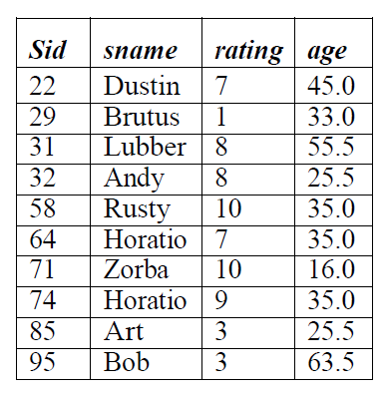
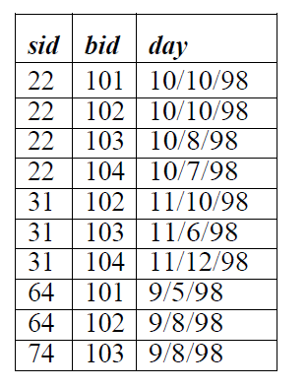
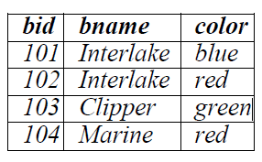
BASIC SQL QUERY
S of Sailors
R of Reserves
B of Boats

Slide 79
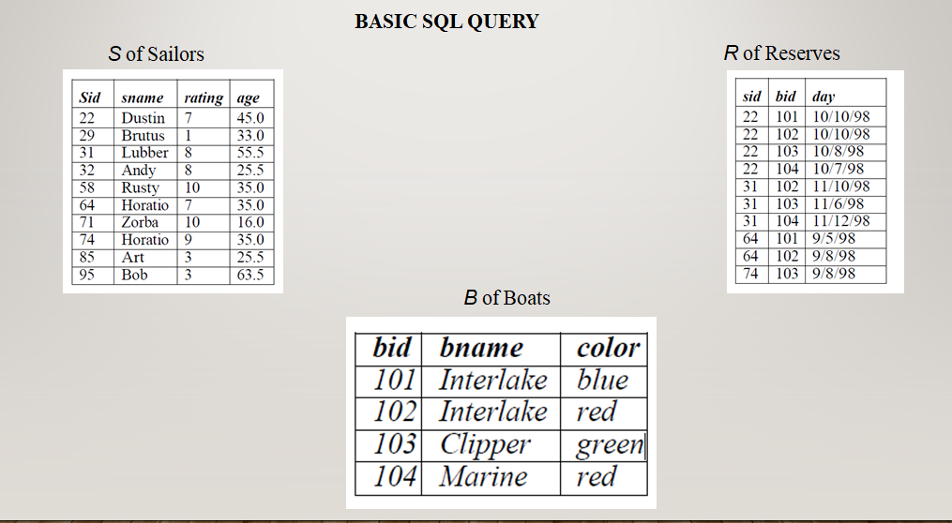
Q: Find the names and ages of all sailors

Slide 80
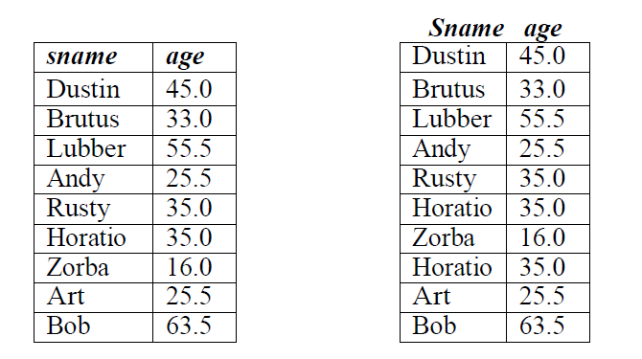
Q: Find the names and ages of all sailors
SELECT DISTINCT S.sname, S.age FROM Sailors S
Answer without DISTINCT

Slide 81
Πsname, age​(Sailors)
{t∣∃s∈Sailors ( t[sname]=s[sname] ∧ t[age]=s[age] )}
{⟨n,a⟩∣∃id∃r ( ⟨id,n,r,a⟩∈Sailors )}

Slide 82
Q: Find all sailors with a rating above 7.

Slide 83
Q: Find all sailors with a rating above 7.
SELECT S.sid, S.sname, S.rating, S.age FROM Sailors AS S WHERE S.rating > 7
SELECT * FROM Sailors WHERE rating > 7;
σrating>7​(Sailors)
{s∣s∈Sailors ∧ s[rating]>7}
{⟨id,n,r,a⟩∣⟨id,n,r,a⟩∈Sailors ∧ r>7}

Slide 84
Q: Find the sids of sailors who have reserved a red boat.

Slide 85
Q: Find the sids of sailors who have reserved a red boat.
SELECT R.sid FROM Boats B, Reserves R
WHERE B.bid = R.bid
AND B.color = ‘red’;
Πsid​(σcolor=′red′​(Reserves⋈Boats))
{t∣∃r∈Reserves ∃b∈Boats ( r[bid]=b[bid] ∧ b[color]=′red′ ∧ t[sid]=r[sid] )}
{⟨sid⟩∣∃bid∃d ( ⟨sid,bid,d⟩∈Reserves ∧ ∃bn ( ⟨bid,bn,′red′⟩∈Boats ) )}

Slide 86
Find the ages of sailors whose name begins and ends with B and has at least three characters.

Slide 87
Q: Find the ages of sailors whose name begins and ends with B and has at least
three characters.
SELECT S.age FROM Sailors S WHERE S.sname LIKE ‘B _%B’
Πage​(σsname LIKE ’B_%B’​(Sailors))
{t∣∃s∈Sailors ( s[sname] LIKE ′B_%B′ ∧ t[age]=s[age] )}
{⟨a⟩∣∃id∃n∃r ( ⟨id,n,r,a⟩∈Sailors ∧ n LIKE ′B_%B′ )}

Slide 88
Q: Find the names of sailors who have reserved a red or a green boat.

Slide 89
UNION
Q: Find the names of sailors who have reserved a red or a green boat.
SELECT S.sname FROM Sailors S, Reserves R, Boats B WHERE S.sid = R.sid
AND R.bid = B.bid AND (B.color = ‘red’ OR B.color = ‘green’)
The OR query can be rewritten as follows:
SELECT S.sname FROM Sailors S, Reserves R, Boats B WHERE S.sid = R.sid AND R.bid = B.bid AND B.color = ‘red’
UNION
SELECT S2.sname FROM Sailors S2, Boats B2, Reserves R2 WHERE S2.sid = R2.sid AND R2.bid = B2.bid AND B2.color = ‘green’
Πsname​(σcolor=′red′ ∨ color=′green′​(Sailors⋈Reserves⋈Boats))
{t∣∃s∈Sailors ∃r∈Reserves ∃b∈Boats ( s[sid]=r[sid] ∧ r[bid]=b[bid] ∧ (b[color]=′red′∨b[color]=′green′) ∧ t[sname]=s[sname] )}
{⟨n⟩∣∃id∃rt∃a ( ⟨id,n,rt,a⟩∈Sailors ∧ ∃d∃bid ( ⟨id,bid,d⟩∈Reserves ∧ ∃bn∃col ( ⟨bid,bn,col⟩∈Boats ∧ (col=′red′∨col=′green′) ) ) )}

Slide 90
Find the names of sailors who have reserved both a red and a green boat.

Slide 91
Find the names of sailors who have reserved both a red and a green boat.
SELECT S.sname FROM Sailors S, Reserves R1, Boats B1, Reserves R2, Boats B2 WHERE S.sid = R1.sid AND R1.bid = B1.bid AND S.sid = R2.sid AND R2.bid = B2.bid AND B1.color=‘red’ AND B2.color = ‘green’
The AND query can be rewritten as follows:
SELECT S.sname FROM Sailors S, Reserves R, Boats B WHERE S.sid = R.sid AND R.bid = B.bid AND B.color = ‘red’
INTERSECT
SELECT S2.sname FROM Sailors S2, Boats B2, Reserves R2 WHERE S2.sid = R2.sid AND R2.bid = B2.bid AND B2.color = ‘green’
Πsname​(σcolor=′red′​(Sailors⋈Reserves⋈Boats)) ∩ Πsname​(σcolor=′green′​(Sailors⋈Reserves⋈Boats))
{ t | ∃s ∈ Sailors ( t[sname] = s[sname] ∧ ∃r1 ∈ Reserves ∃b1 ∈ Boats ( s[sid]=r1[sid] ∧ r1[bid]=b1[bid] ∧ b1[color]='red' ) ∧ ∃r2 ∈ Reserves ∃b2 ∈ Boats ( s[sid]=r2[sid] ∧ r2[bid]=b2[bid] ∧ b2[color]='green' ) ) }
{ <n> | ∃id ∃rt ∃a ( <id, n, rt, a> ∈ Sailors ∧ ∃d1 ∃bid1 ∃bn1 ( <id, bid1, d1> ∈ Reserves ∧ <bid1, bn1, 'red'> ∈ Boats ) ∧ ∃d2 ∃bid2 ∃bn2 ( <id, bid2, d2> ∈ Reserves ∧ <bid2, bn2, 'green'> ∈ Boats ) ) }

Slide 92
Find the sids of all sailors who have reserved red boats but not green boats.

Slide 93
Find the sids of all sailors who have reserved red boats but not green boats.
SELECT S.sid FROM Sailors S, Reserves R, Boats B WHERE S.sid = R.sid AND R.bid = B.bid AND B.color = ‘red’ EXCEPT SELECT S2.sid FROM Sailors S2, Reserves R2, Boats B2 WHERE S2.sid = R2.sid AND R2.bid = B2.bid AND B2.color = ‘green’
we can use the following simpler query:
SELECT R.sid FROM Boats B, Reserves R
WHERE R.bid = B.bid AND B.color = ‘red’
EXCEPT SELECT R2.sid FROM Boats B2,
Reserves R2 WHERE R2.bid = B2.bid AND
B2.color = ‘green’

Slide 94
NESTED QUERIES
A nested query is a query that has another query embedded within it; the embedded query is called a subquery.
Find the names of sailors who have reserved boat 103.
SELECT S.sname
FROM Sailors S
WHERE S.sid IN ( SELECT R.sid
FROM Reserves R
WHERE R.bid = 103 )
The nested subquery computes the (multi)set of sids for sailors who have reserved boat 103 (the set contains 22, 31, and 74 on instances R2 and S3), and the top-level query retrieves the names of sailors whose sid is in this set. The IN operator allows us to test whether a value is in a given set of elements; an SQL query is used to generate
the set to be tested.

Slide 95
Correlated Nested Queries
In the nested queries that we have seen thus far, the inner subquery has been completely independent of the outer query. In general the inner subquery could depend on the row that is currently being examined in the outer query (in terms of our conceptual evaluation strategy). Let us rewrite the following query once more:
The EXISTS operator is another set comparison operator, such as IN. It allows us to test whether a set is nonempty. Thus, for each Sailor row S, we test whether the set of Reserves rows R such that R.bid = 103 AND S.sid = R.sid is nonempty. If so, sailor S has reserved boat 103, and we retrieve the name. The subquery clearly depends on the current row S and must be re-evaluated for each row in Sailors. The occurrence of S in the subquery (in the form of the literal S.sid) is called a correlation, and such queries are
called correlated queries.
Find the names of sailors who have reserved boat number 103.
SELECT S.sname
FROM Sailors S
WHERE EXISTS ( SELECT *
FROM Reserves R
WHERE R.bid = 103
AND R.sid = S.sid )

Slide 96
AGGREGATE OPERATORS
We now consider a powerful class of constructs for computing aggregate values such as MIN and SUM. These features represent a significant extension of relational algebra. SQL supports five aggregate operations, which can be applied on any column, say A, of a relation:
1. COUNT ([DISTINCT] A): The number of (unique) values in the A column.
2. SUM ([DISTINCT] A): The sum of all (unique) values in the A column.
3. AVG ([DISTINCT] A): The average of all (unique) values in the A column.
4. MAX (A): The maximum value in the A column.
5. MIN (A): The minimum value in the A column.

Slide 97
Count the number of different sailor names.
SELECT COUNT( DISTINCT S.sname )
FROM Sailors S
Calculate the average age of all sailors.
SELECT AVG(s.age)
FROM Sailors S
Find the name and the age of the youngest sailor.
SELECT S.sname, S.age
FROM Sailors S
WHERE S.age = (SELECT MIN(S2.age)
FROM Sailors S2 )

Slide 98
The GROUP BY and HAVING Clauses
we want to apply aggregate operations to each of a number of groups of rows in a relation, where the number of groups depends on the relation instance (i.e., is not known in advance). For example, consider the following query.
Find the age of the youngest sailor for each rating level.
SELECT MIN (S.age)
FROM Sailors S
WHERE S.rating = I
where i = 1, 2, . . . , 10. Writing 10 such queries is tedious. More importantly, we may not
know what rating levels exist in advance.

Slide 99
SELECT[ DISTINCT ] select-list
FROM from-list
WHERE qualification
GROUP BY grouping-list
HAVING group-qualification
SELECT S.rating, MIN (S.age)
FROM Sailors S
GROUP BY S.rating

Slide 100
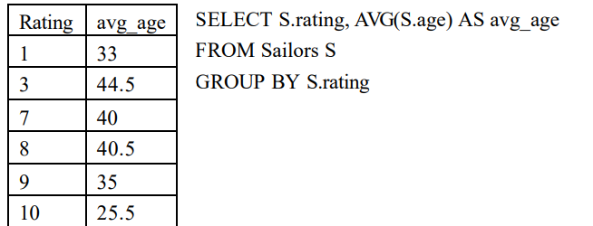
Find the average age of sailors for each rating level.

Slide 101
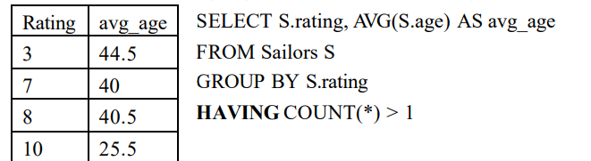
Find the average age of sailors for each rating level that has at least two sailors.

Slide 102
MySQL Triggers
A MySQL trigger is a stored program (with queries) which is executed automatically to respond to a specific event such as insertion, updation or deletion occurring in a table.
1. Before Update Trigger:
As the name implies, it is a trigger which enacts before an update is invoked. If we write an update statement, then the actions of the trigger will be performed before the update is implemented.

Slide 103
create table customer (acc_no integer primary key,
cust_name varchar(20),
avail_balance decimal);
create table mini_statement (acc_no integer,
avail_balance decimal,
foreign key(acc_no) references customer(acc_no) on delete cascade);
insert into customer values (1000, "Fanny", 7000);
insert into customer values (1001, "Peter", 12000);

Slide 104
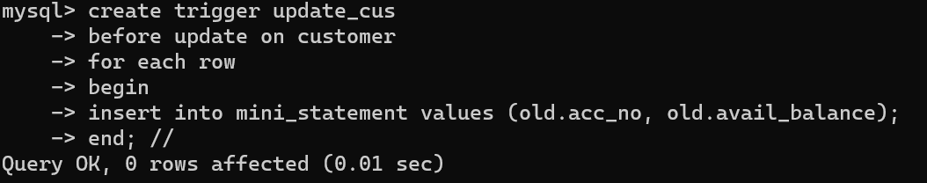
Trigger to insert (old) values into a mini_statement record (including account number and available balance as parameters) before updating any record in customer record/table:

Slide 105
Making updates to invoke trigger:
delimiter;
update customer set avail_balance = avail_balance + 3000 where acc_no = 1001;
update customer set avail_balance = avail_balance + 3000 where acc_no = 1000;

Slide 106
select * from mini_statement;
+--------+---------------+
| acc_no | avail_balance |
+--------+---------------+
| 1001 | 12000 |
| 1000 | 7000 |
+--------+---------------+
2 rows in set (0.0007 sec)

Slide 107
2. After Update Trigger:
As the name implies, this trigger is invoked after an updation occurs. (i.e., it gets implemented after an update statement is executed.).
create table micro_statement (acc_no integer,
avail_balance decimal,
foreign key(acc_no) references customer(acc_no) on delete cascade);
Insert another value into customer:
insert into customer values (1002, "Janitor", 4500);
Query OK, 1 row affected (0.0786 sec)

Slide 108
Trigger to insert (new) values of account number and available balance into micro_statement record after an update has occurred:
delimiter //
create trigger update_after
-> after update on customer
-> for each row
-> begin
-> insert into micro_statement values(new.acc_no, new.avail_balance);
-> end; //

Slide 109
delimiter ;
update customer set avail_balance = avail_balance + 1500 where acc_no = 1002;
select * from micro_statement;
+--------+---------------+
| acc_no | avail_balance |
+--------+---------------+
| 1002 | 6000 |
+--------+---------------+
1 row in set (0.0007 sec)

Slide 110
3. Before Insert Trigger:
As the name implies, this trigger is invoked before an insert, or before an insert statement is executed.
Considering tables:
create table contacts (contact_id INT (11) NOT NULL AUTO_INCREMENT,
last_name VARCHAR (30) NOT NULL, first_name VARCHAR (25),
birthday DATE, created_date DATE,
created_by VARCHAR(30),
CONSTRAINT contacts_pk PRIMARY KEY (contact_id));

Slide 111
delimiter //
create trigger contacts_before_insert
before insert
on contacts for each row
begin
DECLARE vUser varchar(50);
select USER() into vUser;
SET NEW.created_date = SYSDATE();
SET NEW.created_by = vUser;
end; //
Trigger to insert contact information such as name, birthday and creation-date/user into a table contact before an insert occurs:

Slide 112
Making an insert to invoke the trigger:
delimiter;
insert into contacts values (1, "Newton", "Enigma",
str_to_date ("19-08-1999", "%d-%m-%Y"),
str_to_date ("17-03-2018", "%d-%m-%Y"), "xyz");
Output:
select *from contacts;
+------------+-----------+------------+------------+--------------+----------------+
| contact_id | last_name | first_name | birthday | created_date | created_by |
+------------+-----------+------------+------------+--------------+----------------+
| 1 | Newton | Enigma | 1999-08-19 | 2019-05-11 | root@localhost |
+------------+-----------+------------+------------+--------------+----------------+

Slide 113
4. After Insert Trigger:
As the name implies, this trigger gets invoked after an insert is implemented.
Consider tables:
create table contacts (contact_id int (11) NOT NULL AUTO_INCREMENT,
last_name VARCHAR(30) NOT NULL,
first_name VARCHAR(25), birthday DATE,
->CONSTRAINT contacts_pk PRIMARY KEY (contact_id));
create table contacts_audit (contact_id integer,
created_date date,
created_by varchar (30));

Slide 114
Trigger to insert contact_id and contact creation-date/user information into contacts_audit record after an insert occurs:
delimiter //
create trigger contacts_after_insert
-> after insert
-> on contacts for each row
-> begin
-> DECLARE vUser varchar(50);
->
-> -- Find username of person performing the INSERT into table
-> SELECT USER() into vUser;
->
-> -- Insert record into audit table
-> INSERT into contacts_audit
-> ( contact_id,
-> created_date,
-> created_by)
-> VALUES
-> ( NEW.contact_id,
-> SYSDATE(),
-> vUser );
-> END; //

Slide 115
Making an insert to invoke the trigger:
insert into contacts values (1, "Kumar", "Rupesh",
str_to_date("20-06-1999", "%d-%m-%Y"));
Output:
select *from contacts_audit;
+------------+--------------+----------------+
| contact_id | created_date | created_by |
+------------+--------------+----------------+
| 1 | 2019-05-11 | root@localhost |
+------------+--------------+----------------+
1 row in set (0.0006 sec)

Slide 116
5. Before Delete Trigger:
As the name implies, this trigger is invoked before a delete occurs, or before deletion statement is implemented.
Consider tables:
create table contacts (contact_id int (11) NOT NULL AUTO_INCREMENT,
last_name VARCHAR (30) NOT NULL, first_name VARCHAR (25),
birthday DATE, created_date DATE, created_by VARCHAR(30),
CONSTRAINT contacts_pk PRIMARY KEY (contact_id));
create table contacts_audit (contact_id integer, deleted_date date, deleted_by varchar(20));

Slide 117
Trigger to insert contact_id and contact deletion-date/user information into contacts_audit record before a delete occurs:
delimiter //
create trigger contacts_before_delete
-> before delete
-> on contacts for each row
-> begin
->
-> DECLARE vUser varchar(50);
->
-> -- Find username of person performing the DELETE into table
-> SELECT USER() into vUser;
->
-> -- Insert record into audit table
-> INSERT into contacts_audit
-> ( contact_id,
-> deleted_date,
-> deleted_by)
-> VALUES
-> ( OLD.contact_id,
-> SYSDATE(),
-> vUser );
-> end; //

Slide 118
Making an insert and then deleting the same to invoke the trigger:
delimiter;
insert into contacts values (1, "Bond", "Ruskin",
str_to_date ("19-08-1995", "%d-%m-%Y"),
str_to_date ("27-04-2018", "%d-%m-%Y"), "xyz");
delete from contacts where last_name="Bond";
Output:
select *from contacts_audit;
+------------+--------------+----------------+
| contact_id | deleted_date | deleted_by |
+------------+--------------+----------------+
| 1 | 2019-05-11 | root@localhost |
+------------+--------------+----------------+
1 row in set (0.0007 sec)

Slide 119
6. After Delete Trigger:
As the name implies, this trigger is invoked after a delete occurs, or after a delete operation is implemented.
Consider the tables:
create table contacts (contact_id int (11) NOT NULL AUTO_INCREMENT,
last_name VARCHAR (30) NOT NULL, first_name VARCHAR (25),
birthday DATE, created_date DATE, created_by VARCHAR (30),
CONSTRAINT contacts_pk PRIMARY KEY (contact_id));
create table contacts_audit (contact_id integer, deleted_date date, deleted_by varchar(20));

Slide 120
Trigger to insert contact_id and contact deletion-date/user information into contacts_audit record after a delete occurs:
create trigger contacts_after_delete
-> after delete
-> on contacts for each row
-> begin
->
-> DECLARE vUser varchar(50);
->
-> -- Find username of person performing the DELETE into table
-> SELECT USER() into vUser;
->
-> -- Insert record into audit table
-> INSERT into contacts_audit
-> ( contact_id,
-> deleted_date,
-> deleted_by)
-> VALUES
-> ( OLD.contact_id,
-> SYSDATE(),
-> vUser );
-> end; //

Slide 121
Making an insert and deleting the same to invoke the trigger:
delimiter;
insert into contacts values (1, "Newton", "Isaac",
str_to_date ("19-08-1985", "%d-%m-%Y"),
str_to_date ("23-07-2018", "%d-%m-%Y"), "xyz");
delete from contacts where first_name="Isaac";
Output:
select *from contacts_audit;
+------------+--------------+----------------+
| contact_id | deleted_date | deleted_by |
+------------+--------------+----------------+
| 1 | 2019-05-11 | root@localhost |
+------------+--------------+----------------+
1 row in set (0.0009 sec)

Slide 122
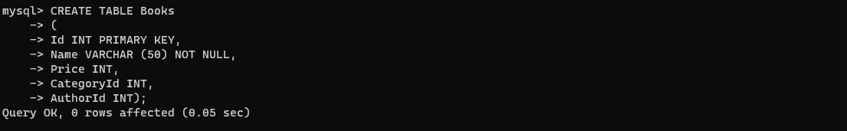
NESTED, CORRELATED, JOIN QUERIES

Slide 123
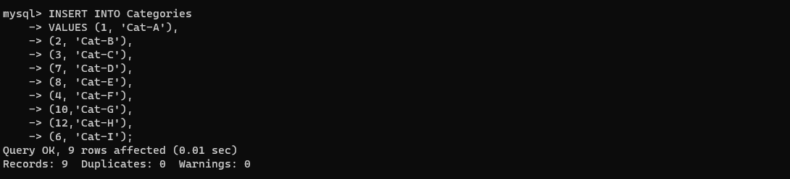
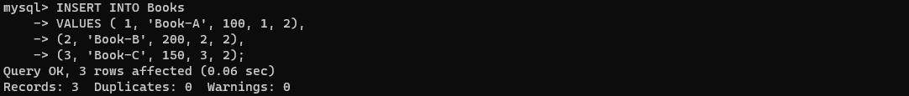

Slide 124
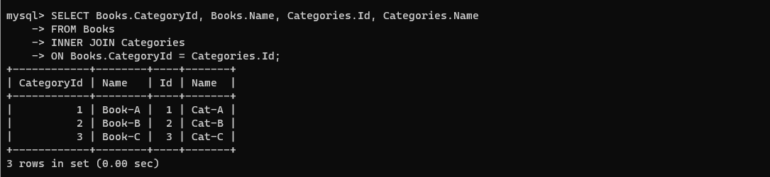
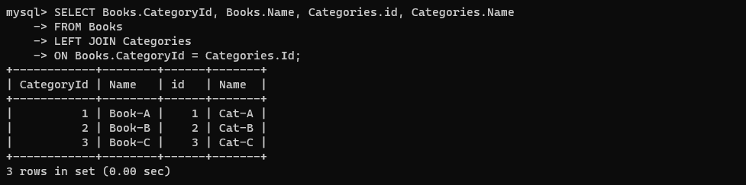

Slide 125
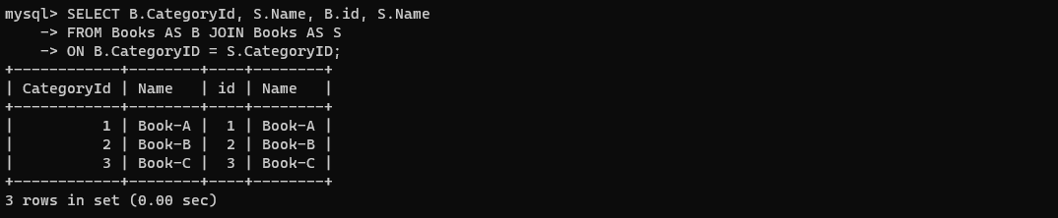

Slide 126
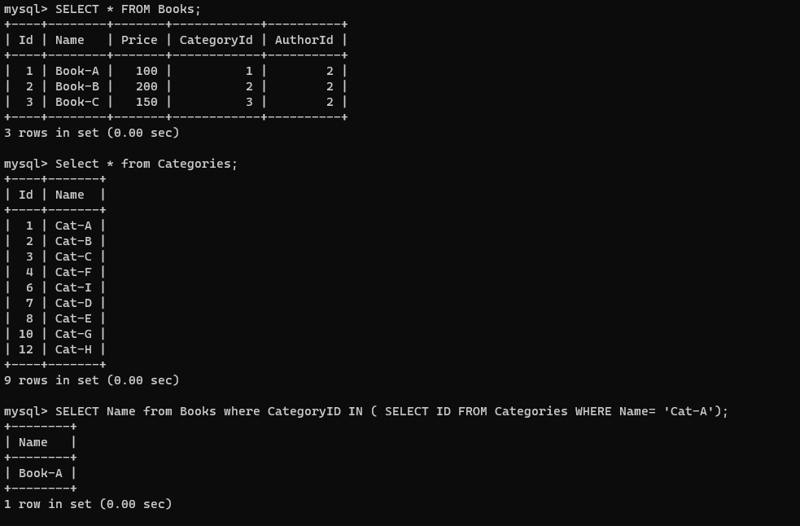
NESTED QUERY

Slide 127
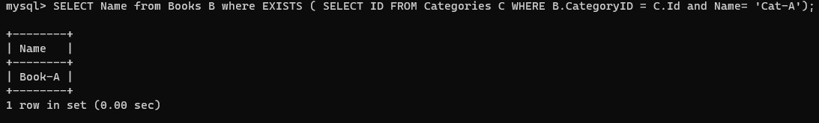
CORRELATED QUERY

Slide 128
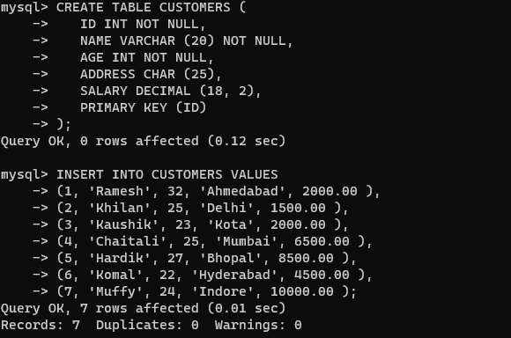
ANY AND ALL OPERATORS

Slide 129
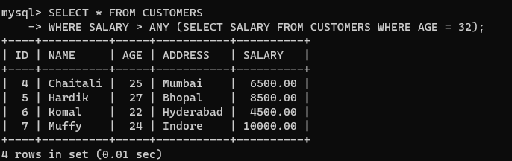
The ANY operator is used to verify if any single record of a query satisfies the required condition.
This operator returns a TRUE, if the given condition is satisfied for any of the values in the range. If none of the values in the specified range satisfy the given condition, this operator returns false. You can also use another query (subquery) along with this operator.
let us list out the details of all the CUSTOMERS whose SALARY is greater than the SALARY of any customer whose AGE is 32

Slide 130
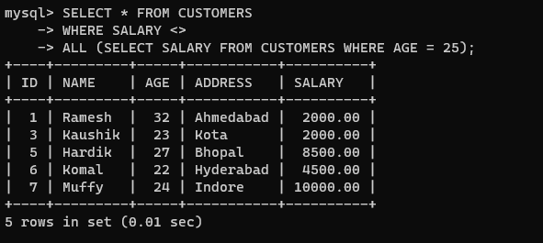
The SQL ALL operator returns all the records of the SELECT statement.
It returns TRUE if the given condition is satisfied for ALL the values in the range.
It always returns a Boolean value.
It is used with SELECT, WHERE and HAVING statements in SQL queries.
The data type of the values returned from a subquery must be the same as the outer query expression data type.

Slide 131
THANK YOU

